Slide 1
Exploring AWS Spot Instances within Kubernetes clusters
Under the guidance of Dan McPherson and Ravi Gudimetla
Aditya Kadam
Kevin Rodrigues
Nikhil Singh
Suryateja Gudiguntla

Slide 2
Deployed Prometheus on Kubernetes Clusters in AWS
Created a simple algorithm(one metric) to take decisions add/remove nodes depending on SLA
Deployed Descheduler for load balancing
Previous Sprint

Slide 3
Previous goals
To develop the final algorithm and decide what action to be taken regarding new nodes
Testing limitations of the application under all types of workloads and defining the thresholds for the set of metrics to be used as SLA
Running the application for a specific period and calculating the cost saved

Slide 4
Descheduler

Slide 5
Why not descheduler
Descheduler cannot check for current usage of nodes, neither cpu nor memory
It takes decisions based on the requests and limits set by the pods
These values are not set for the sample application we chose to deploy as we needed the application’s pods to be best-effort pods
Thus, balancing nodes using descheduler became unusable
We decide to use the scheduler of kubernetes in a modified manner to balance the nodes

Slide 6
Balancing nodes
Instead of increasing an application’s number of replicas when the performance is low, we decide to create an empty node first to accommodate these extra pods
The new node’s type is decided by the controller
Once the new node is ready and validated by the cluster, we scale up the application pods
As default scheduler avoids adding replicas to the same node, the new pods are only scheduled to the empty node that we have just created
This helps to balance the nodes

Slide 7
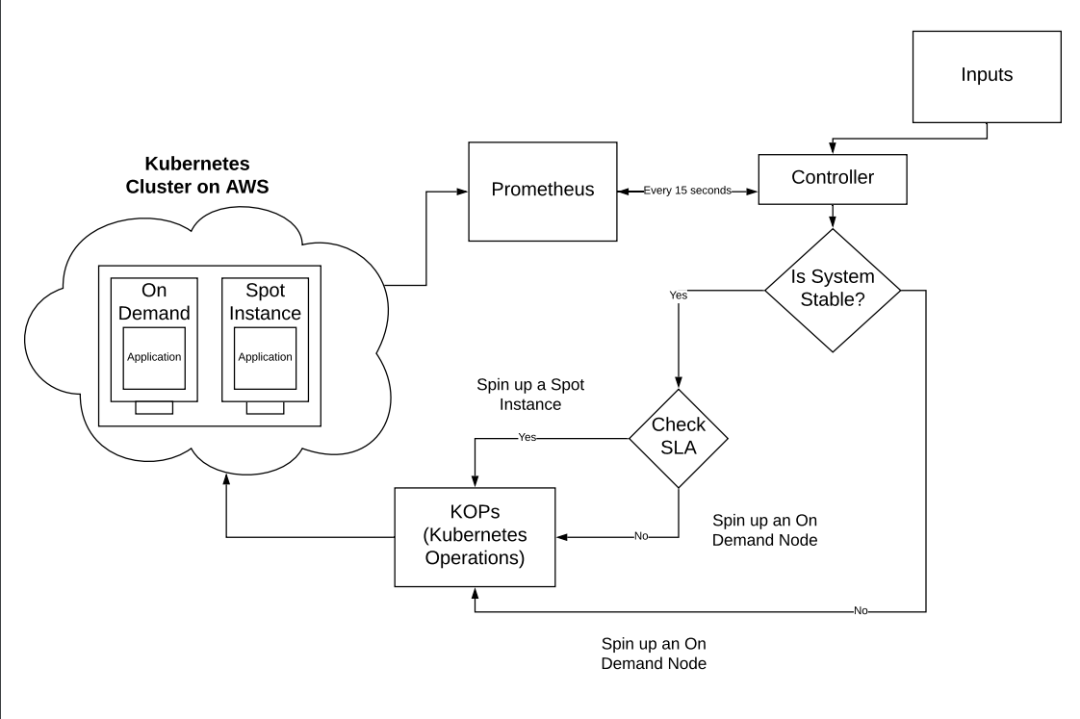
Workflow of our Project

Slide 8
Leveraged performance metrics used by Site Reliability Engineering(SRE) by Google
Latency
Throughput
Error rate
An ordered map is used to store the timestamp as key and application performance is stored as the corresponding value
If any of the above metrics are worse than the defined threshold for stability
The application performance is set to low
If all the above metrics are better than the thresholds
The application performance is set to stable
Notes:
The metrics which we used to define the performance of application is leveraged from the concept of SRE.SRE is site reliability engineering which means ro script and automate the operations part of the application that is the maintenance and support. So for any web application the important metrics used by sre is below.
An ordered map is a data structure which stores the records in the order in which it was inserted. Over the here our key is the Timestamp and performance is the corresponding value.
In the given timestamp if the performance of the application is below than the threshold then the performance will be set to low and it higher than the threshold it is stable.

Slide 9
Budget
Budget is the time that the application can afford to perform poorly, over a certain period of time.
Any time the application performing poorly, we reduce the budget.
For all scaling tasks, we observed that the application is performing poorly so we reduce the budget by corresponding values.
If the application is stable, then the overall budget time is increased.
All the decision are taken considering the budget
Notes:
Budget is the time which the application can afford to run poorly that is if the application has to run for an hour with 90 sla then it afford to be down for 6 minutes i.e 90%60.
So if the application starts performing poorly then the budget will be reduced by the time duration for which it was down. This happened while we were scaling up the application, which is one of the example when we reduced the budget.
Suppose my application is running for 2 hours and the sla is 90. In the first hour if the performance was good then budget gets carry forward to the next hour.
All decisions are based on the budget which will be explained in the later slides.

Slide 10
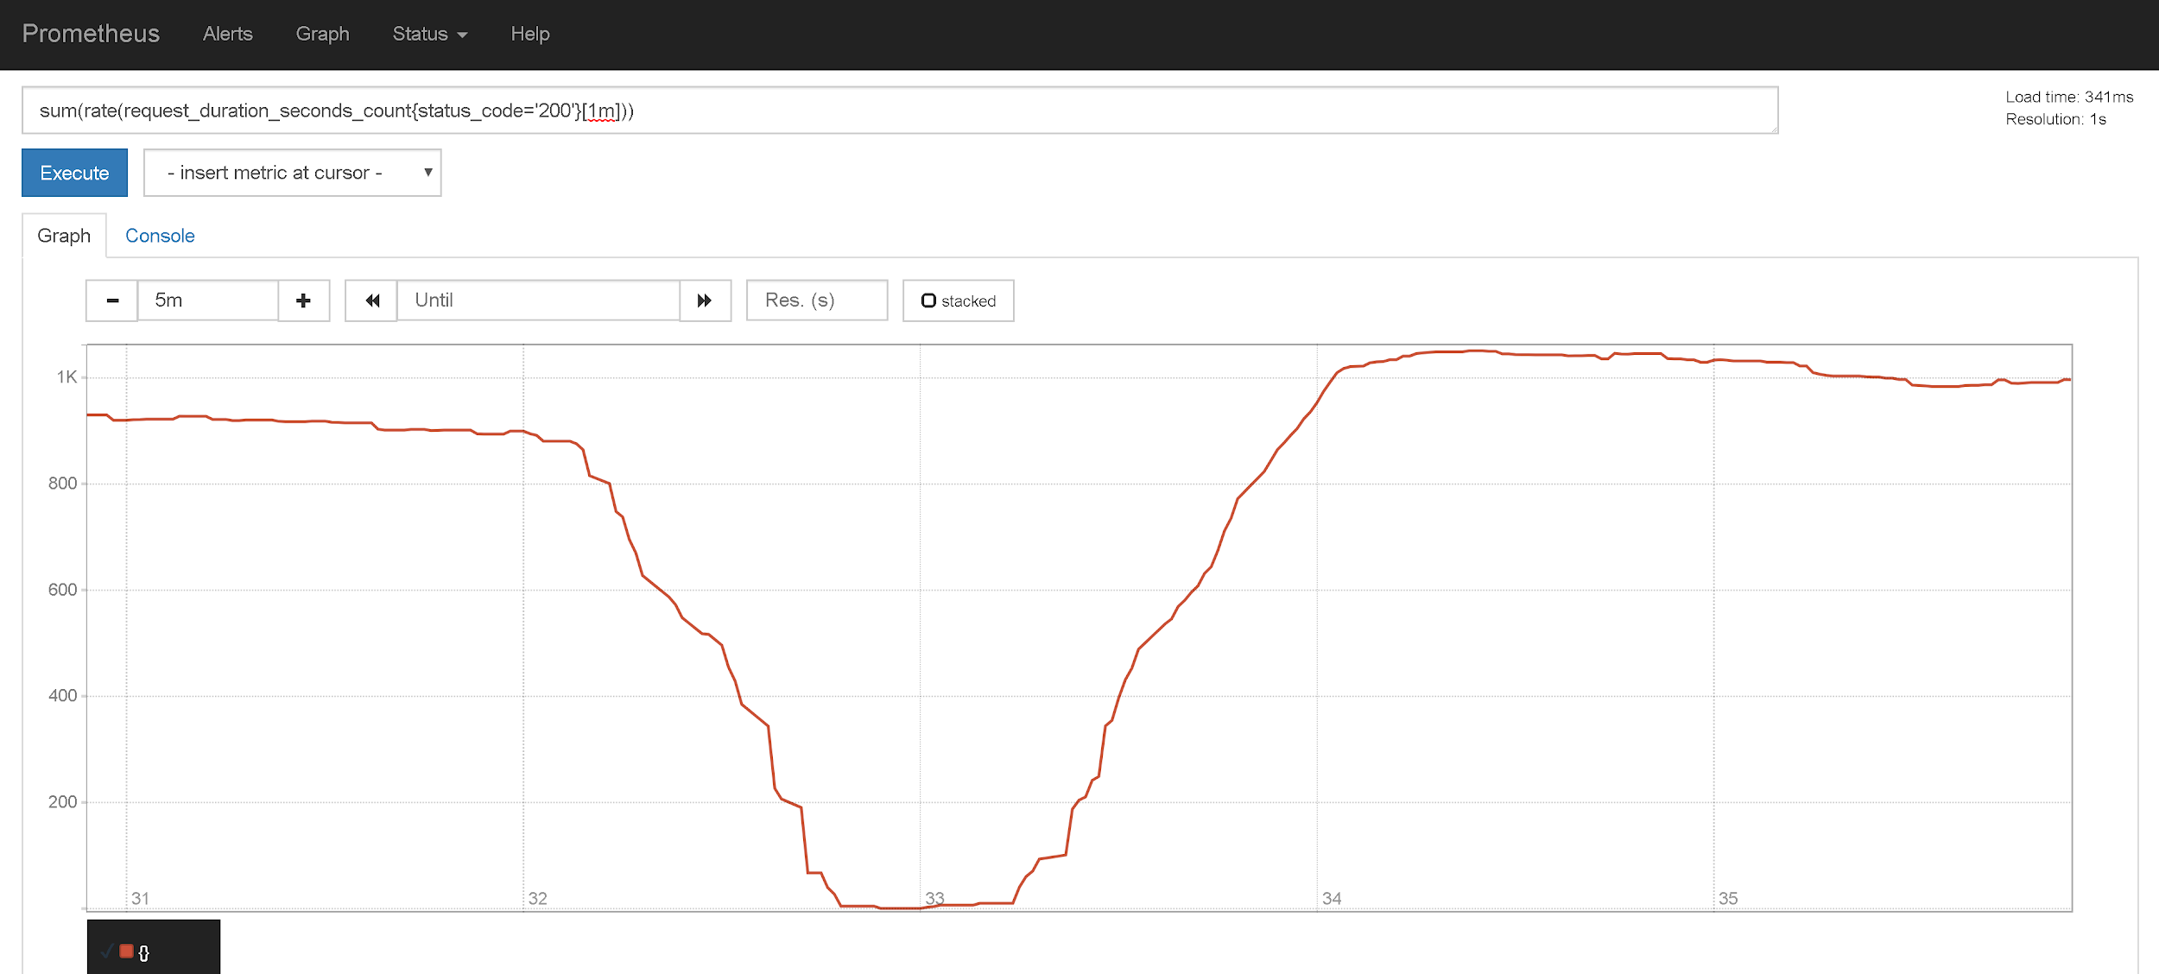
Throughput (number of “200” requests)
Time (minutes)
Example of throughput getting reduced due to scaling
Notes:
Here is an example when we scale up an application and the throughput gets reduced for sometime which eventually leads to reducing the budget.

Slide 11
Algorithm

Slide 12
High requests
Check the latency, throughput and error-rate every 15 seconds
For the previous 2 minutes, if the flag is set to low performance consistently, then we decide to add a new node
If we have the budget to afford a spot instance, we create a spot instance; else an on-demand node is created
After validation is completed, we scale up the application
Metrics are measured again after a defined time interval, to allow the new pods to be scheduled
Notes:
So there are 2 cases, high load and low load.
We calculate load by the number of requests the application is getting.
We check for the metrics and we know that the system isnt stable so we set the flag to be false for that timestamp
Creating spot instance is a risk.

Slide 13
Low requests and system is stable
Check the metrics every 15 seconds and set the flag to true
If budget available
Add empty new spot instance
Delete on-demand node
Shift the pods to spot instance
Verify if all pods are scheduled

Slide 14
Spot Termination
Once we get the 2 minute notification from AWS about a spot instance to be terminated:
Scale down the application
Drain the spot instance
Create a new node
This new node can be a spot instance or on-demand, based on available budget
Validate the new node being added
Scale up the application

Slide 15
Demo Run
We created a cluster with 3 on demand nodes and deployed prometheus along with an application with 3 replicas.
Increased the load
Measured the latency, throughput and error rate
Controller observed the system to be stable and had enough budget, so it decided to replace one on demand with one spot instance.
Spin up a spot instance and wait for validation
Delete the existing on demand node (all pods are scheduled to new spot instance)
Observed that we saved 25% costs with 98% uptime in one day

Slide 16
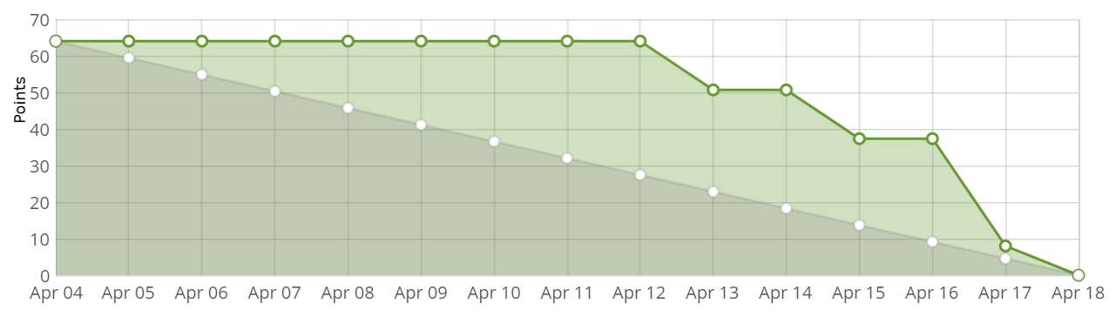
Burndown for Sprint 5

Slide 17
Future Scope
Improve the algorithm to handle more edge cases
Control over eviction and scheduling of pods
Create a config file
Add a model to predict the termination of spot instance, so that the controller is more prepared.

